Slide 1
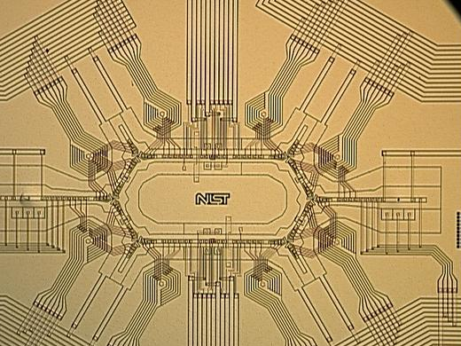
Quantum state manipulation
of trapped ions
D. J. Wineland, NIST, Boulder, Colorado

Slide 2
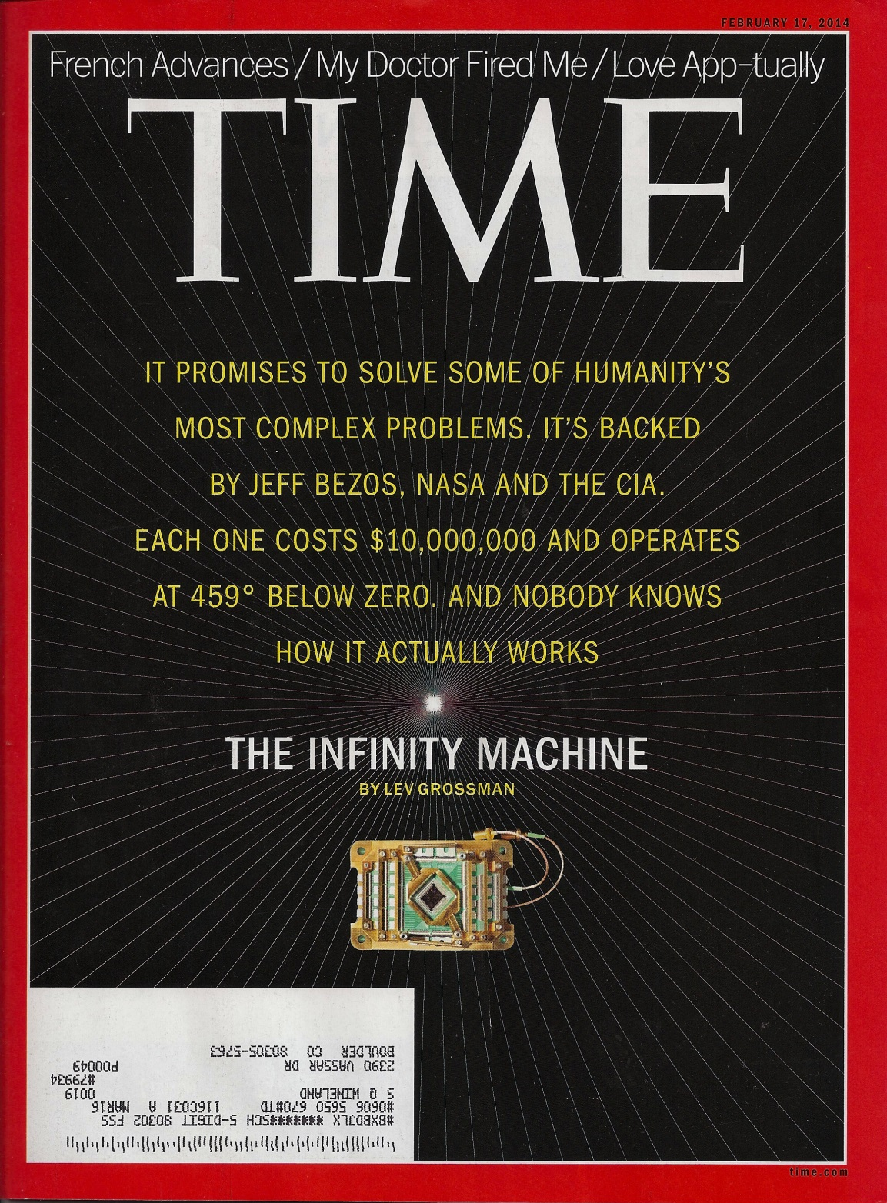
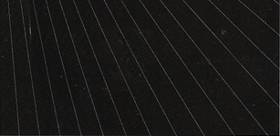
Time magazine
Article about D-Wave
quantum computer
February 17, 2014

Slide 3
Summary:
♦ ion qubits
♦ Spectroscopy & atomic clocks
♦ quantum limited measurements
& quantum information
◊ elements of quantum computing
◊ quantum simulation
♦ Mostly NIST examples,
but many people & many groups worldwide

Slide 4
Mercury ion “qubit”, 1981 →
superpositions α|0⟩ + β|1⟩
“trap” electrodes
|²D_{5/2}⟩ ≡ |1⟩ (τ ≅ 0.1 s)
|²S_{1/2}⟩ ≡ |0⟩
λ = 282 nm
ultraviolet light
¹⁹⁹Hg⁺
1 mm

Slide 5
Qubit measurement
α⇦0 +β⇦1
²P_{1/2} (τ ≅ 2 ns)
|1⟩
|0⟩
1 mm

Slide 6
α⇦0 +β⇦1 → ⇦0
²P_{1/2}
|1⟩
Hg⁺
|0⟩
194 nm
1 mm
photomultiplier

Slide 7
α⇦0 +β⇦1 → ⇦1
²P_{1/2}
|1⟩
Hg⁺
|0⟩
194 nm
1 mm
photomultiplier

Slide 8
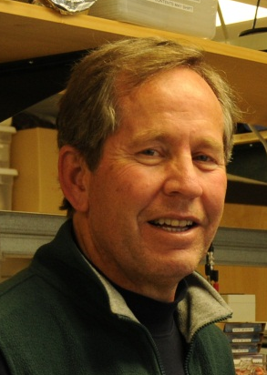
Single ¹⁹⁹Hg⁺ ions for (optical) clocks:
J. C. Bergquist et al., (NIST)1981 →
²P_{1/2}
²D_{5/2}
Hg⁺
²S_{1/2}
Jim Bergquist
• trapping ⇒ first-order Doppler shift → 0
• laser cooling ⇒ time dilation small
• trapping in high vacuum at 4 K
⇒ small environmental perturbations (collisions, black body shifts, etc.)
⇒ first clock with systematic uncertainly (7x10⁻¹⁷) below Cesium
- W. H. Oskay et al., Phys. Rev. Lett. 97, 020801 (2006)

Slide 9
Single ¹⁹⁹Hg⁺ ions for (optical) clocks:
J. C. Bergquist et al., (NIST)1981 →
²P_{1/2}
²D_{5/2}
Hg⁺
²S_{1/2}
Jim Bergquist
Plus several other ion species:
⁸⁸Sr⁺, ¹⁷¹Yb⁺, ²⁷Al⁺, ⁴⁰Ca⁺, ¹¹⁵In⁺
review: P. Gill, Phil. Trans. R. Soc. A 369, 4109 (2011)
• trapping ⇒ first-order Doppler shift → 0
• laser cooling ⇒ time dilation small
• trapping in high vacuum at 4 K
⇒ environmental perturbations (collisions, black body shifts, etc.) small
²²⁹Th³⁺
(PTB, UCLA
Kuzmich group)
⇒ first clock with systematic uncertainly (7x10⁻¹⁷) below Cesium
- W. H. Oskay et al., Phys. Rev. Lett. 97, 020801 (2006)

Slide 10
fine-scale energy structure:
Transition frequency
≅ 1 x 10¹⁵ Hz
…
Δm = 1 transition
Frequency
≅ 10⁶ – 10⁷ Hz
²D_{5/2}
m=2
m=1
²D_{5/2} = |1⟩
m=0
…
m=2
²S_{1/2}
m=1
m=0
motion quantum
states
²S_{1/2} = |0⟩
1 mm
¹⁹⁹Hg⁺

Slide 11
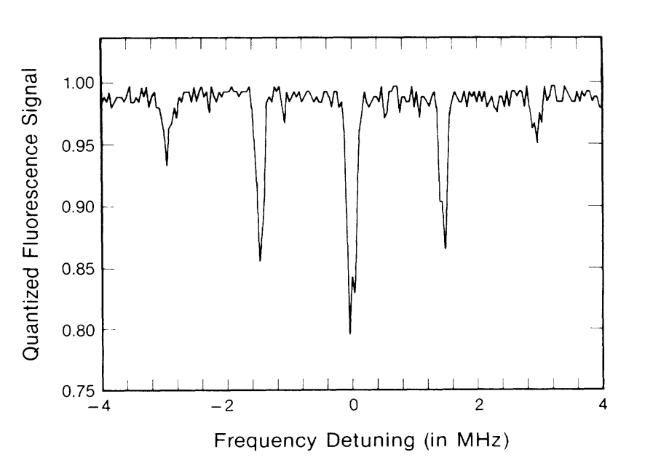
²P_{1/2}
alternately
apply
Single-ion spectroscopy:
²D_{5/2}
Hg⁺
282 nm
²S_{1/2}
Prob. (S_{1/2}) →
…
²D_{5/2}
m=2
m=1
m=0
Δm = 0
…
m=2
m=1
J. C. Bergquist, W. M. Itano, D. J. Wineland, Phys. Rev. A36, 428 (1987).
²S_{1/2}
m=0

Slide 12
²P_{1/2}
alternately
apply
…
…
²D_{5/2}
²D_{5/2}
m=2
²D_{5/2}
m=2
m=1
m=1
m=0
m=0
Δm = -1
Δm = +1
Hg⁺
282 nm
…
…
m=2
m=2
²S_{1/2}
²S_{1/2}
m=1
²S_{1/2}
m=1
m=0
m=0
Prob. (S_{1/2}) →
J. C. Bergquist, W. M. Itano, D. J. Wineland, Phys. Rev. A36, 428 (1987).

Slide 13
Ground-state cooling
(put atom in
m=0 motion state)
…
…
…
²D_{5/2}
m=2
²D_{5/2}
m=2
²D_{5/2}
m=2
m=1
m=1
m=1
m=0
m=0
m=0
Δm = -1
Δm = -1
Δm = -1
Δm = 0
Δm = 0
…
…
…
m=2
m=2
m=2
²S_{1/2}
m=1
²S_{1/2}
m=1
²S_{1/2}
m=1
m=0
m=0
m=0
Prob. (S_{1/2}) →
F. Diedrich et al., PRL 62, 403 (1989)

Slide 14

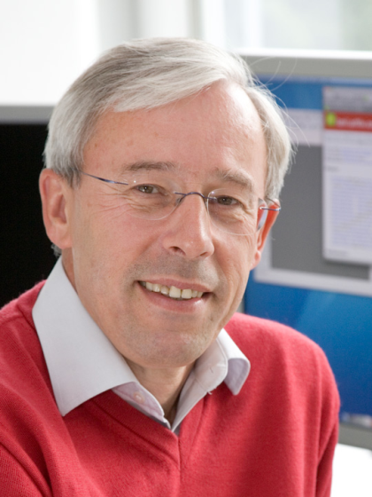
Atomic ion quantum computation:
J. I. Cirac, P. Zoller, Phys. Rev. Lett. 74, 4091 (1995)
(emerged from 1994 ICAP, Boulder, CO)
1. START MOTION IN GROUND STATE
2. SPIN → MOTION MAP
3. SPIN ↔ MOTION GATE
Ignacio Cirac
Peter Zoller
MOTION “DATA BUS”
(e.g., center-of-mass mode)
INTERNAL STATE “SPIN” QUBIT
• • • •
• • • •
|↑⟩
|m = 3⟩
|m = 2⟩
|m = 1⟩
|m = 0⟩
“m” for
motion
|↓⟩
Motion qubit states

Slide 15
SPIN → MOTION MAP
●
●
●
m = 4
|1⟩
quantized motion levels
m = 3
m = 2
m = 1
m = 0
|0⟩
●
“π - pulse”
●
●
m = 4
m = 3
m = 2
m = 1
m = 0
(α|0⟩ + β|1⟩) |m=0⟩
→ |0⟩ (α|m=0⟩ + β|m=1⟩)
initial state
transfer information onto motion

Slide 16
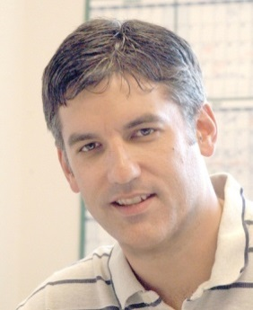
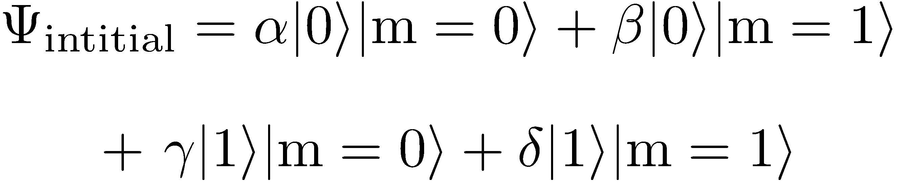
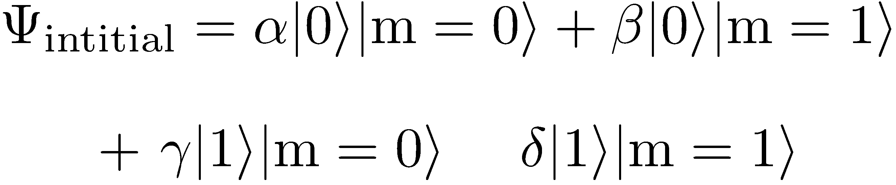
SPIN-MOTION GATE:
(Chris Monroe et al.
PRL, ’95)
1
m=1
m=0
aux
m=1
m=0
|0⟩
m=1
m=0

Slide 17
Atomic ion experimental groups
pursuing QIP:
Aarhus
Amherst
The Citadel
Tsinghua (Bejing)
U.C. Berkeley
U.C.L.A.
Duke
ETH (Zürich)
Freiburg
Garching (MPQ)
Georgia Tech
Griffiths
Hannover
Innsbruck
JQI (U. Maryland)
Lincoln Labs
Imperial (London)
Mainz
MIT
NIST
Northwestern
NPL
Osaka
Oxford
Paris (Université Paris)
Pretoria, S. Africa
PTB
Saarland
Sandia National Lab
Siegen
Simon Fraser
Singapore
SK Telecom, S. Korea
Sussex
Sydney
U. Washington
Weizmann Institute
+ many other platforms:
neutral atoms, Josephson junctions,
quantum dots, NV centers in diamond,
single photons, …

Slide 18
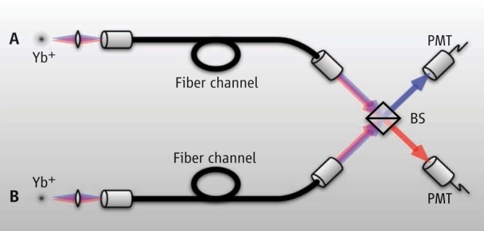
Scale up qubit numbers?
● small electrodes: use lithographic techniques
● move ions in multi-zone arrays for scaling
microfab at:
GTRI, Sandia, NIST,
Berkeley, Innsbruck,
Mainz, ….
Optically entangle remote ions (Monroe et al.)
1 mm
Jason Amini et al.
(NIST)

Slide 19
More robust entangling operations & logic gates:
use state-dependent optical dipole forces
Joint qubit states
e.g.,
laser beam
standing waves
|↓⟩ ⇔ |0⟩, |↑⟩ ⇔ |1⟩
Early proposals:
Milburn, Schneider, James (1999)
Sørensen & Mølmer (1999, 2000)
Solano, de Matos Filho, Zagury (1999)
Notes:
Now for the more interesting part, the two-qubit entangling operations. The key here is that the ions can talk to each other through their motion and the coulomb interaction. So to make the spins of the ions talk to each other, we have to couple the spin and the motion. This can be done using the sideband transitions I just showed using various schemes that I will mention in a bit

Slide 20
Joint qubit states
Notes:
But first just to give you a flavor, I’ll describe a simple method that can be used which is to take advantage of the force placed on an ion due to the AC Stark Shift when there is a light intensity gradient. And the size of the AC Stark shift on an ion can depend on what spin state that ion is in. So imagine I apply a laser beam with an intensity gradient such that the force due to the AC Stark shift on spin 0 ions will be down and will be up for spin 1 ions. That will displace the 00 state down.

Slide 21
Joint qubit states
Notes:
And displace the 11 ions up.

Slide 22
Joint qubit states
Notes:
But the 1,0 and 0,1 states will go in different directions.

Slide 23
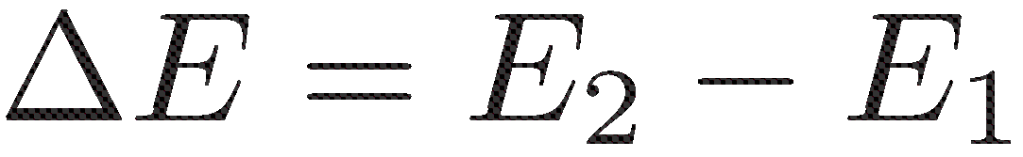
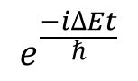
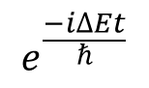
Joint qubit states
$$e^{\frac{−i∆Et}{ℏ}}$$
E₁
E₂
$$e^{\frac{−i∆Et}{ℏ}}$$
Notes:
These two configurations have different energies. So if I apply the force for a time t, the 01 and 10 states will acquire a phase difference from the 00 and 11 states. I can set this phase to be i by controlling the time.

Slide 24
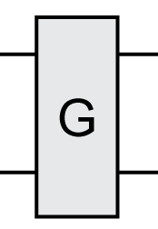
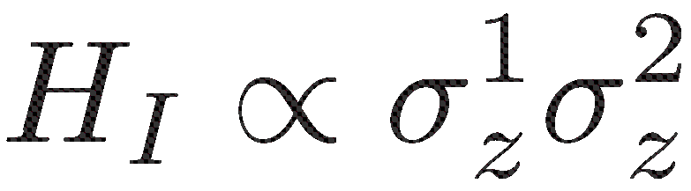

e..g.,
$$≡$$
AC Versions: moving standing wave excites motion near mode frequency
● D. Leibfried, et al, Nature 422, 412 (2003)
●
●
● C. J. Balance et al., (Oxford group), arXiv:1406.5473
E₁
E₂
error per gate 0.0011(7)
world’s record!
simulates spin-spin interaction
Notes:
This operation can be used to entangle pairs of ions. In matrix form the operation looks like this.

Slide 25
Simulation:
Exps: Shätz et al., Freiburg
Monroe et al., U. Maryland
Blatt et al., Innsbruck
Bollinger et al., NIST
Center-of-mass)mode
tilt mode
“moving
standing
wave” state-
dependent
forces
transverse mode spectrum (9 ions)
add magnetic field:
for ω_{force} ≅ ω_{COM}
⇒ GHZ states
Transverse Ising model
( ω_{force} > ω_{COM})
(J_{i,j} > 0,
anti-ferromagnetic)
Porras and Cirac, PRL 92, 207901 (2004)
Porras and Cirac, PRL 96, 250501 (2006)
Deng, Porras, Cirac, PRA 7782, 063407 (2005)
Taylor and Calarco, PRA , 062331 (2008)
Johanning et al., J. Phys. B 42, 154009 (2009)
Schneider, Porras, Schätz, Rep. Prog. Phys. 75, 024401(2012)
● ● ● ●
vary α by
varying detuning
α = 0 - ~3

Slide 26

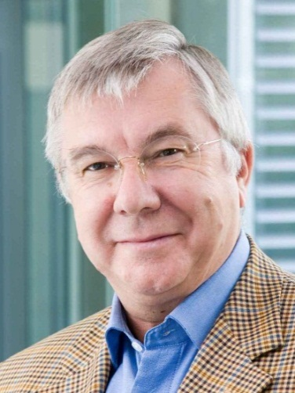
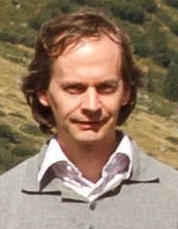
Entanglement propagation
Maryland
P. Richerme et al., Nature 511, 198 (2014)
Chris Monroe
Innsbruck
P. Jurcevi et al., Nature 511, 202 (2014)
Rainer Blatt
Christian Roos

Slide 27
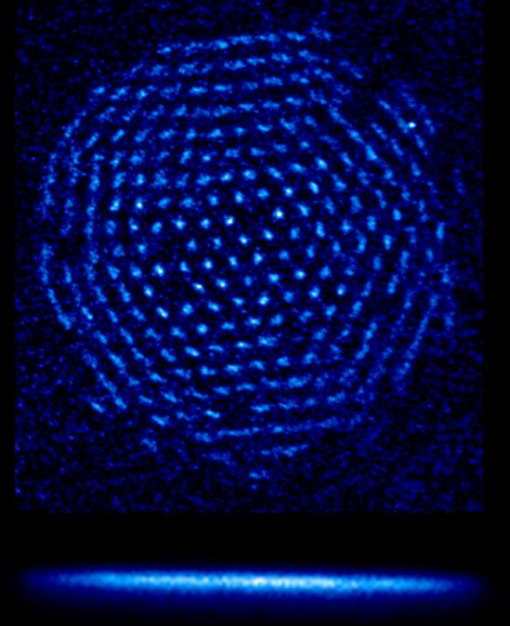
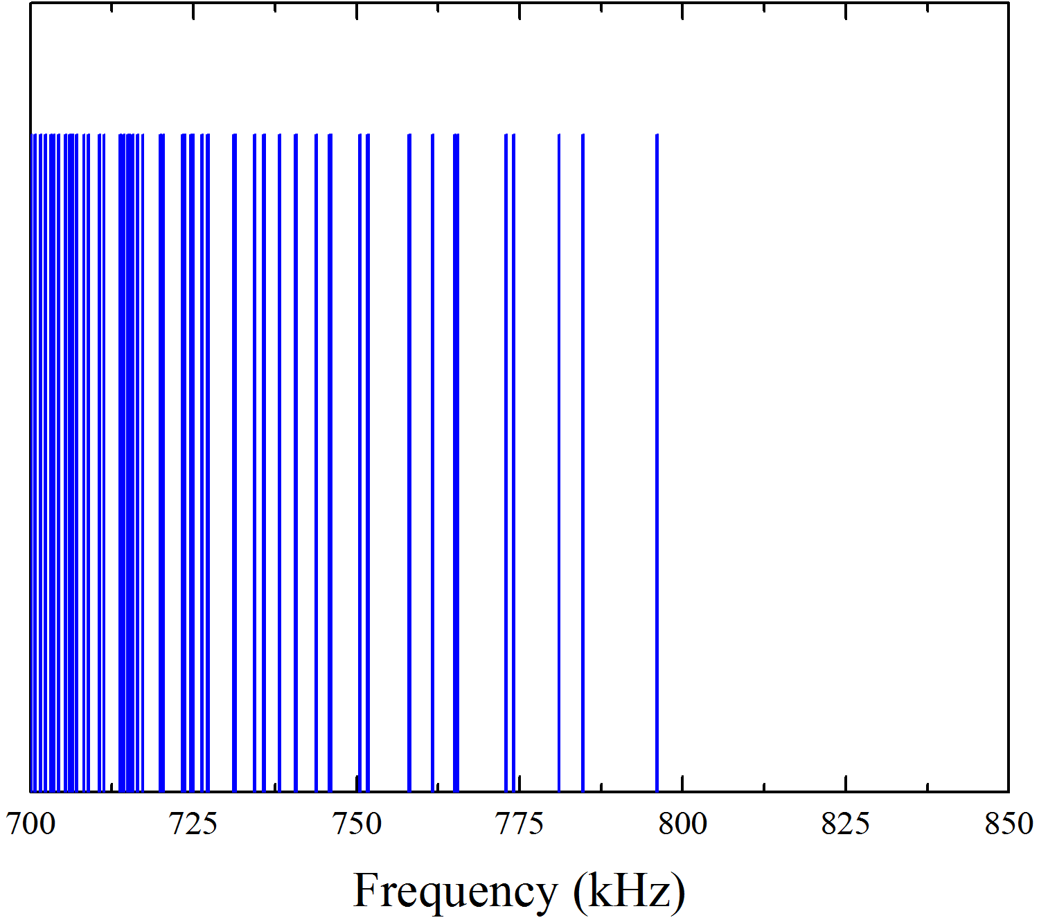
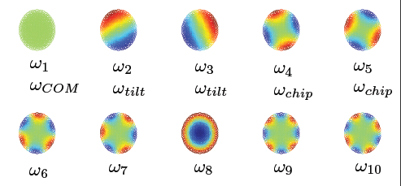
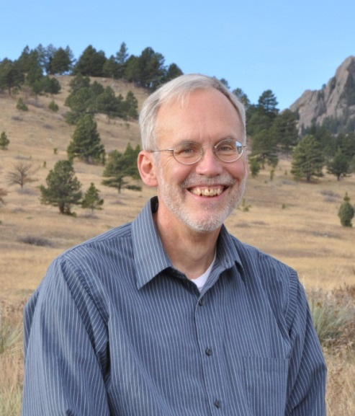
2-D array (Penning trap)
Simulation in
Wigner crystal
d
• N > 100 spins
• “self assembled” triangular lattice
transverse mode spectrum (modes out of plane)
N ≅ 200
700
kHz
800
kHz
top view
potato chip
tilt
COM
• Benchmarked Ising interactions with mean field theory
To do: implement new trap & laser beams to increase J_{i,j}
relative to spontaneous emission
John Bollinger, + J. Bohnet, J. Britton, B. Sawyer
J. Britton et. al., Nature 484, 489 (2012); B. Sawyer et al., PRL 108, 213003 (2012); PRA 89, 033408 (2014)
Notes:
alpha variation same for linear and 2-D

Slide 28
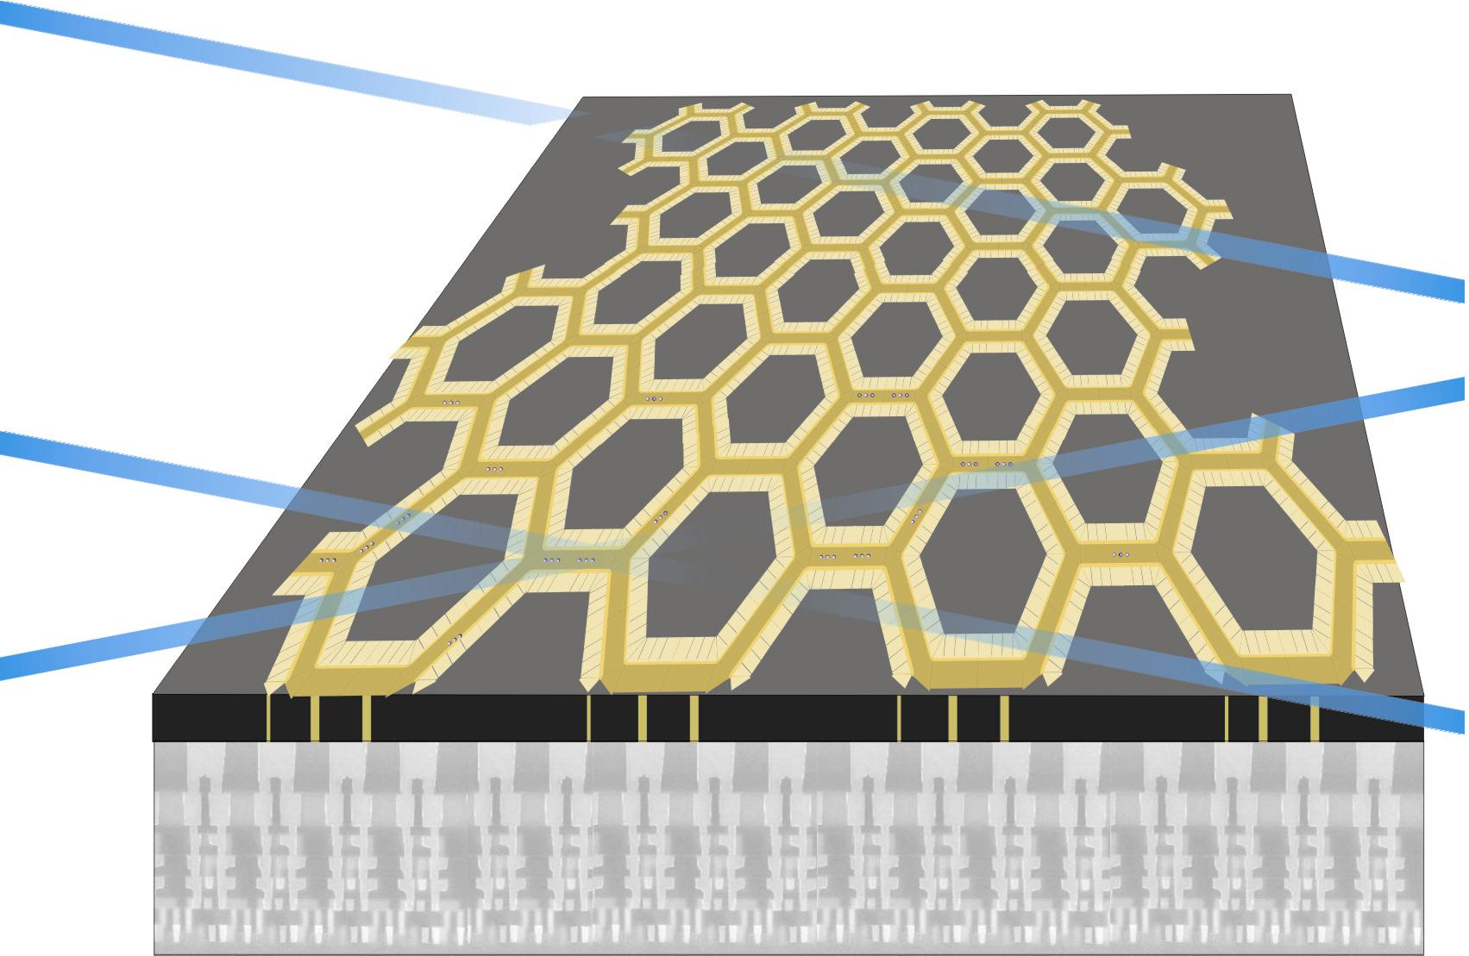

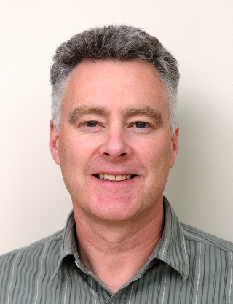
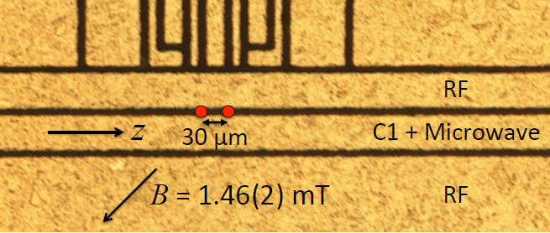
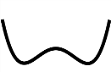
Engineered geometry for simulations
A. Wilson, D. Leibfried et al.
Laser beams in plane with ions
Building block:
H_{I} = ћgσ_{x}σ_{x}, g/2π = 450 Hz
ions in separated wells (d = 30 μm)
(A. Wilson et al., Nature 512, 57 (2014).
Didi
Leibfried
Andrew
Wilson
VIAS
double well →
control electronics
below surface trap
Chiaverini and Lybarger, PRA 77, 022324 (2008)
Schmied, Wesenberg, Leibfried, PRL 102, 233002 (2009)
Schmied, Wesenberg, Leibfried, New J. Phys. 13 115011 (2011)

Slide 29
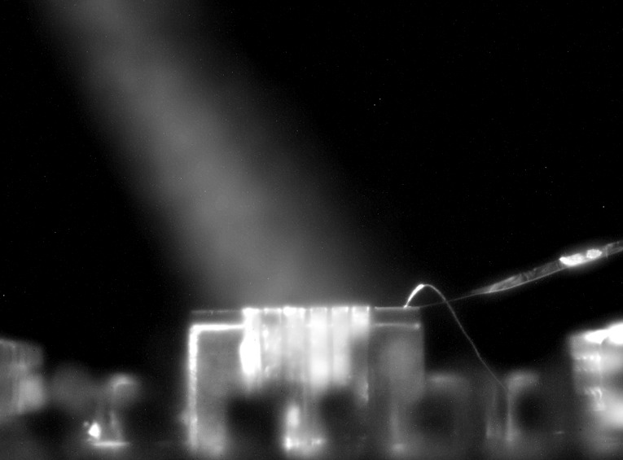
Ion heating: try to reduce with surface science techniques:
collaboration with D. Hite, K. McKay, D. Pappas (NIST, Boulder)
Cryo cooling helps too:
• L. Deslauriers, S. Olmschenk, D. Stick, W. K. Hensinger,
J. Sterk, and C. Monroe, Phys. Rev. Lett. 97, 103007
(2006).
• J. Labaziewicz, Y. Ge, D. R. Leibrandt, S. X. Wang, R.
Shewmon, and I. L. Chuang, Phys. Rev. Lett. 101, 180602
(2008).
•J. Chiaverini and J. M. Sage, Phys. Rev. A 89, 012318 (2014).
……
Ar⁺ beam
cleaning
x 100 heating reduction
side view,
surface-electrode
trap
Review:
M. Brownnutt, M. Kumph, P. Rabl, and R. Blatt,
arXiv: 1409.6572
D. A. Hite et al., PRL 109, 103001 (2012) (Ar⁺ beam sputtering)
N. Daniilidis et al., (Häffner group) PRB 89, 245435 (2014): similar gain

Slide 30
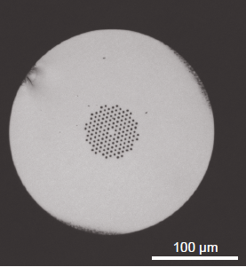
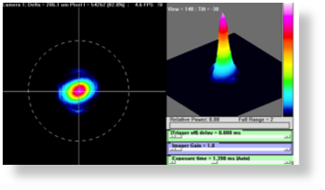
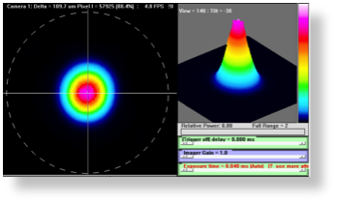
Better laser beam control: UV Fibers? • better position stability • improve beam shape
Recipe:
- Hydrogen loading of fiber (~ 100 atm, ~ 1 week)
- “cure” with UV (transmitted beam)
Input
Output
Preliminary:
σ_{z}-σ_{z} phase gate
with fibers: F > 0.995
Output - 98% overlap with Gaussian TEM₀₀ mode
Y. Colombe, D. H. Slichter, A. C. Wilson et al. Optics Express 22, 19783 (2014)
Hollow core crystal fibers:
F. Gebert, M. H. Frosz, T. Weiss, Y. Wan, A. Ermolov, N. Y. Joly, P. O. Schmidt,
and P. St. J. Russell, Opt. Express, 22, 15388-15396 (2014).

Slide 31
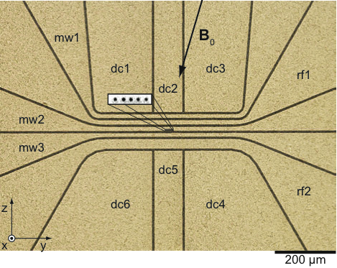
Get rid of lasers?
C. Ospelkaus et al., Nature 476, 181 (2011).
U. Warring et al., PRA 87, 013437 (2013); PRL 110, 173002 (2013)
D. P. L. Aude et al., Appl. Phys. B 114, 3 (2014) (Oxford)
²⁵Mg⁺ ions trapped
30 μm from surface
current lead for
μ-wave hyperfine transitions
10 μm gold on AlN substrate

Slide 32
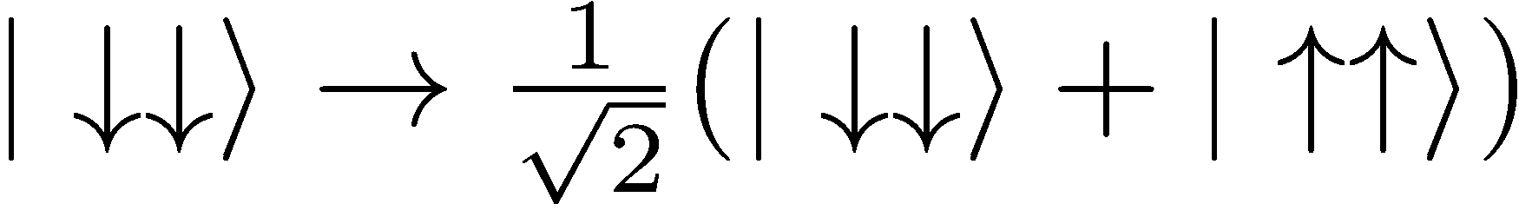
Make B(t) =0, maximize B-field gradient
⇒ state-dependent magnetic forces
currents for
sideband transitions
F = 0.76(3)
10 μm gold on AlN substrate
C. Ospelkaus et al., Nature 476, 181 (2011).
U. Warring et al., PRA 87, 013437 (2013); PRL 110, 173002 (2013)

Slide 33
Potential benefits:
• better control with RF/microwaves
• “all electronic” integrated control
• no spontaneous emission
• ground state cooling not necessary
• laser overhead vastly reduced
Make B(t) =0, maximize B-field gradient
currents for
sideband transitions
F = 0.76(3)
10 μm gold on AlN substrate
C. Ospelkaus et al., Nature 476, 181 (2011).
U. Warring et al., PRA 87, 013437 (2013); PRL 110, 173002 (2013)

Slide 34
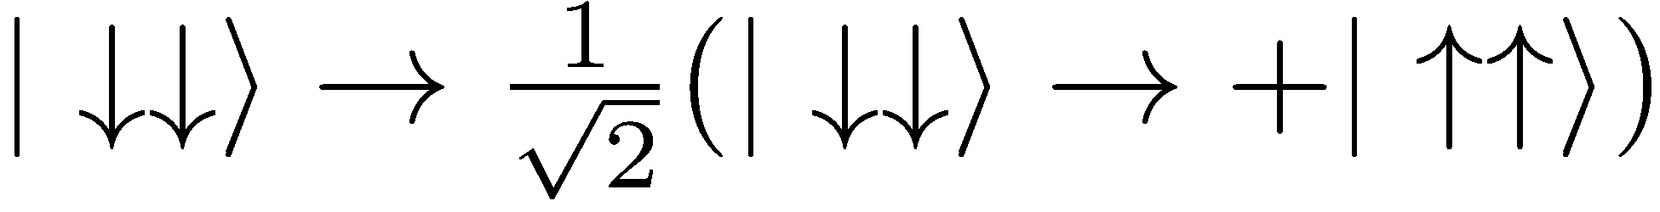
New apparatus (David Allcock, Daniel Slichter)
- better optical access
- shorter leads (lower RF and microwave loss)
- separate loading zone
- Ar+ cleaning
- ability to cool (LN₂)
- better thermal & electrical conductivity at 80K
- new power amps
Make B(t) =0, maximize B-field gradient
currents for
sideband transitions
F = 0.76(3)
10 μm gold on AlN substrate
C. Ospelkaus et al., Nature 476, 181 (2011).
U. Warring et al., PRA 87, 013437 (2013); PRL 110, 173002 (2013)

Slide 35
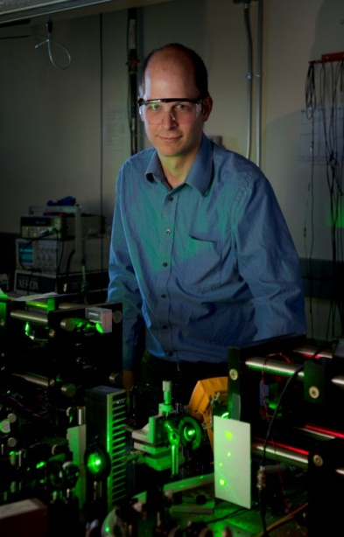
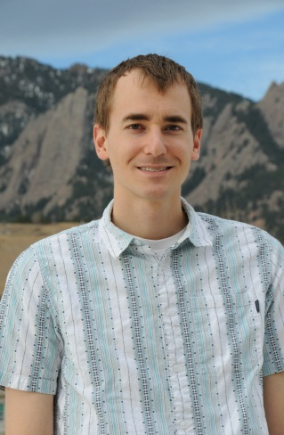
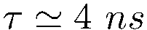
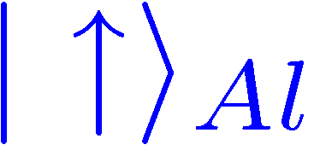
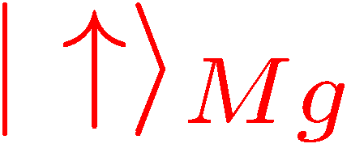
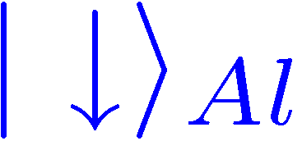
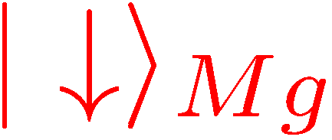
Al⁺ “quantum-logic clock” (T. Rosenband, D. Lebrandt et al.)
Coulomb
interaction
trap at
~ 300 K
¹P₁
²P_{3/2}
³P₀
Till Rosenband
David Leibrandt
λ = 280 nm
Al⁺
(F=2, m_{F} = -2)
λ = 167 nm
²⁵Mg⁺
²S_{1/2}
¹S₀
(F=3, m_{F} = -3)
α|↓⟩_{Al} + β|↑⟩_{Al} → motion superposition → α|↓⟩_{Mg} + β|↑⟩_{Mg}
uncertainty = 8.0 x 10⁻¹⁸ (time dilation shift)
C. W. Chou et al., PRL 104, 070802 (2010)

Slide 36
Moving target!
Jun Ye’s group (JILA), Sr neutral atoms in optical lattice:
Δf/f₀(systematic) = 6.4 x 10⁻¹⁸
(B. J. Bloom et al., Nature 506, 71 (2014))
ΔT ≈ 30 mK
PTB, Braunschweig, Germany
Δf/f₀(systematic) = 3.3 x 10⁻¹⁸
(unpublished)
weak (octupole) transition, laser Stark shifts, …
H. Katori group (Riken) Sr neutral atoms in optical lattice
Δf/f₀(systematic) = 7.2 x 10⁻¹⁸ (arXiv:1405.4071)
2.1

Slide 37
WE DO KNOW HOW IT WORKS
…and why it doesn’t work
FACTORING MACHINE
probably decades away
QUANTUM SIMULATION
maybe within next decade?

Slide 38
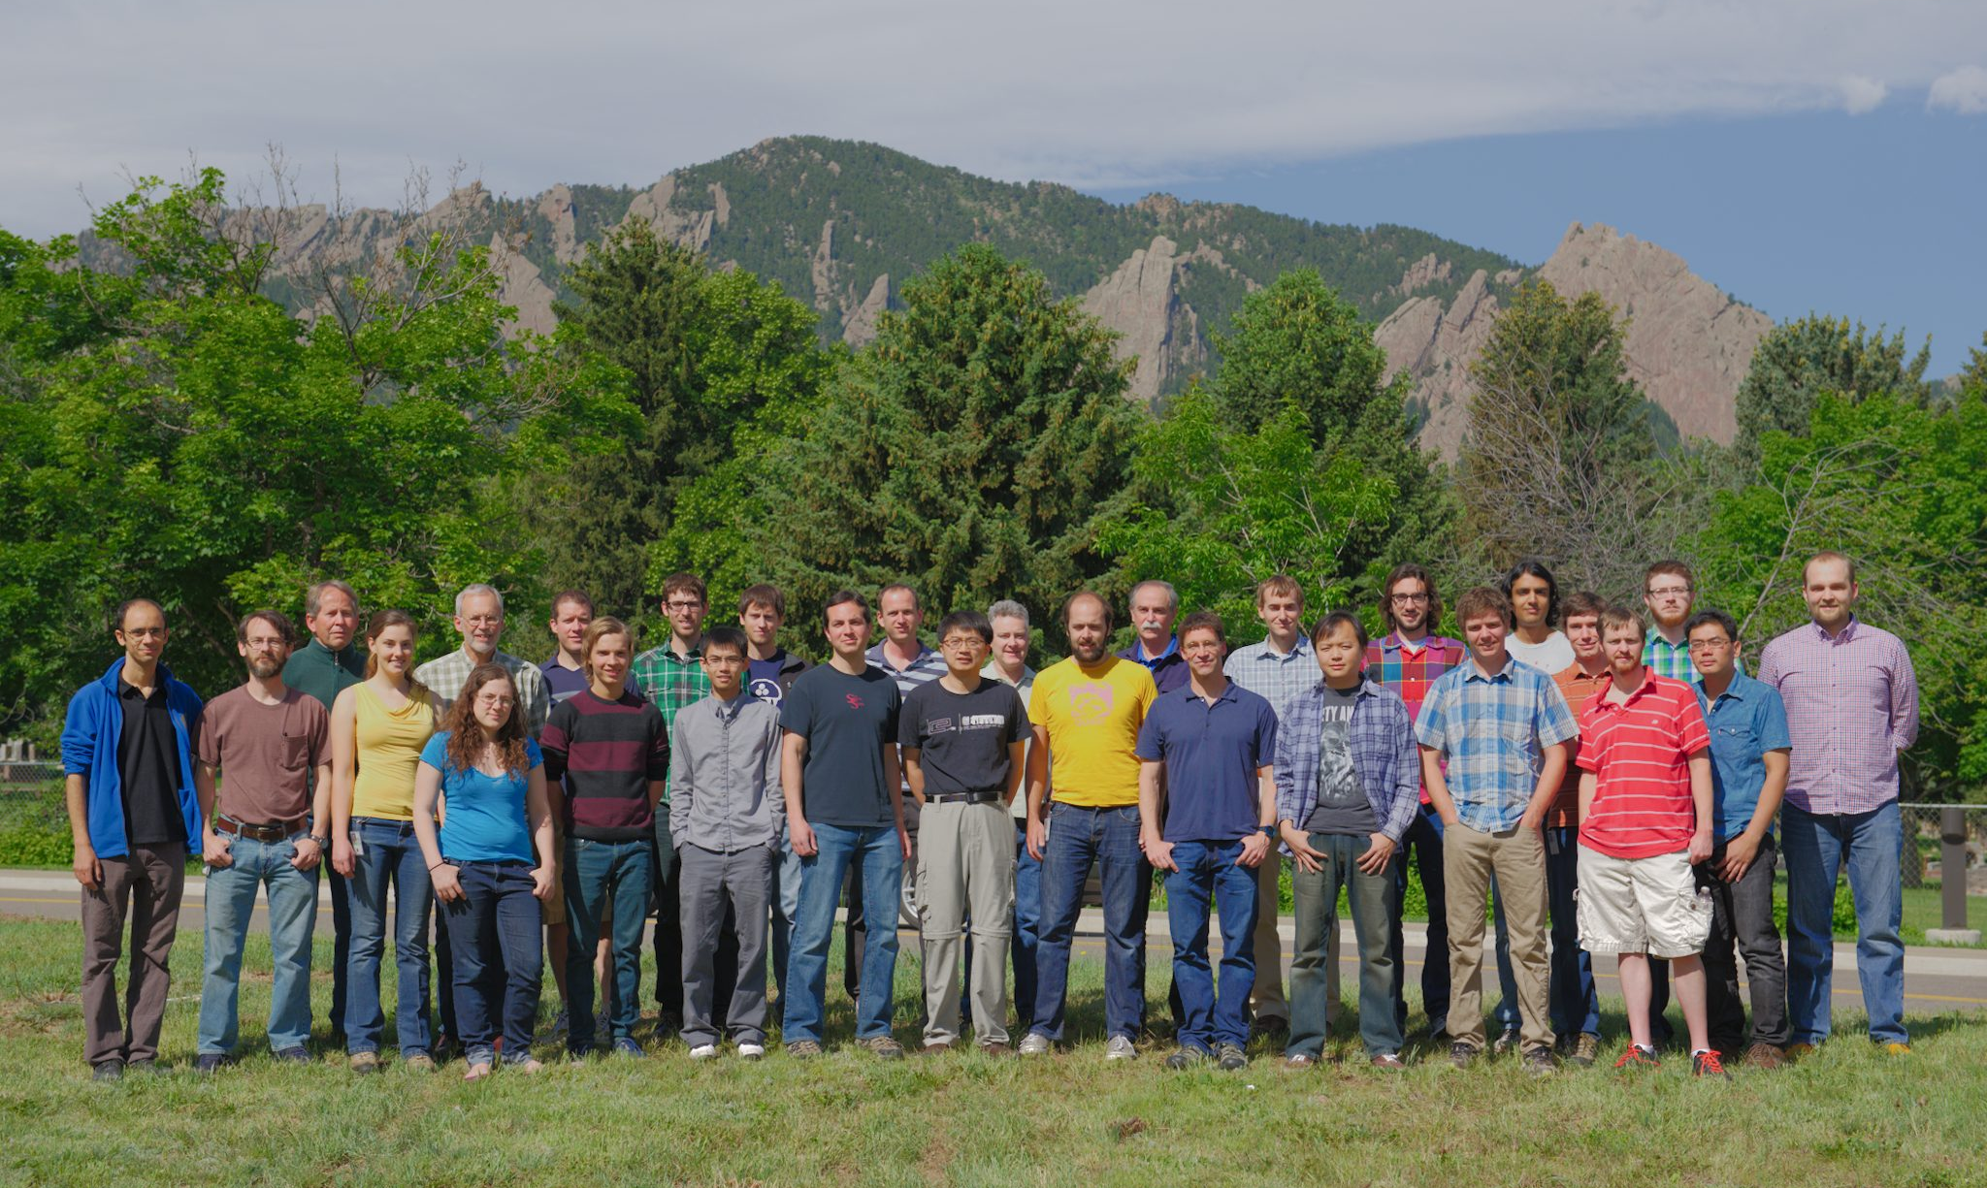






NIST “IONS” June 2014
Jim Bergquist, John Bollinger, Joe Britton, Justin Bonet, Ryan Bowler, John Gaebler, Andrew Wilson, Dave Wineland, David Leibrandt, Peter Burns, Raghu Srinivas, Shon Cook, Robert Jordens
David Hume Ting Rei Tan
Shlomi Kotler, Dustin Hite, Katie McCormick ,Susanna Todaro, Leif Waldner, Yiheng Lin, Daniel Slichter, James Chou, David Allcock, Didi Leibfried, Jwo-Sy Chen, Sam Brewer, Kyle McKay
Not pictured: Brian Sawyer, Till Rosenband, Wayne Itano, Dave Pappas, Bob Drullinger

